Slide 1
EN 410 Energy Management
Gurubalan Annadurai
guru.a@iitb.ac.in

Slide 2
Course Outline
General Aspects of Energy Management and Energy Audit
Energy scenario
Energy audit
Monitoring and targeting
Economics
Energy Billing
Energy Efficiency and Energy Performance Assessment of Electrical Utilities
Electrical systems
Electricity distribution
Motors and drives
Energy Efficiency and Energy Performance Assessment of Thermal Utilities
Boilers
Steam distribution system
Furnaces
Insulation
Waste heat recovery
Heat exchangers and their networks
Cogeneration
Compressed air systems
Refrigeration and air conditioning systems
Pumps
Fans
….Many more (environment, PAT Scheme)

Slide 4
Course Pre-requisites
Thermodynamics
Heat transfer
Fluid mechanics

Slide 5
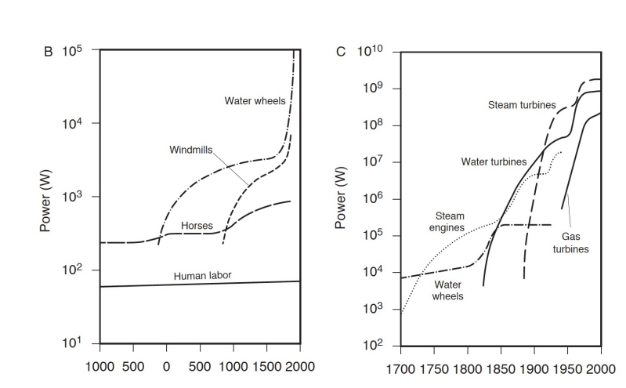
Energy and Civilization
Humans branched off from the other species roughly 200,000 years ago
About 5,000 years ago, humans began to build cities, to store food and use
About 1,500 years ago humans used tools to civilize less-hospitable areas
About 300 years ago we began to build machines to do real work
About 200 years ago, we began to extract energy rich sources from the earth

Slide 6
Types
Primary/secondary energy
Renewable/non-renewable energy
Commercial/non-commercial energy

Slide 7
Energy Sources
Coal
Oil
Natural Gas
Nuclear
Biomass
Renewable
Reserve to production ratio
The tonne of oil equivalent (toe) is a unit of energy defined as the amount of energy (41868 MJ) released by burning one tonne of crude oil.

Slide 8
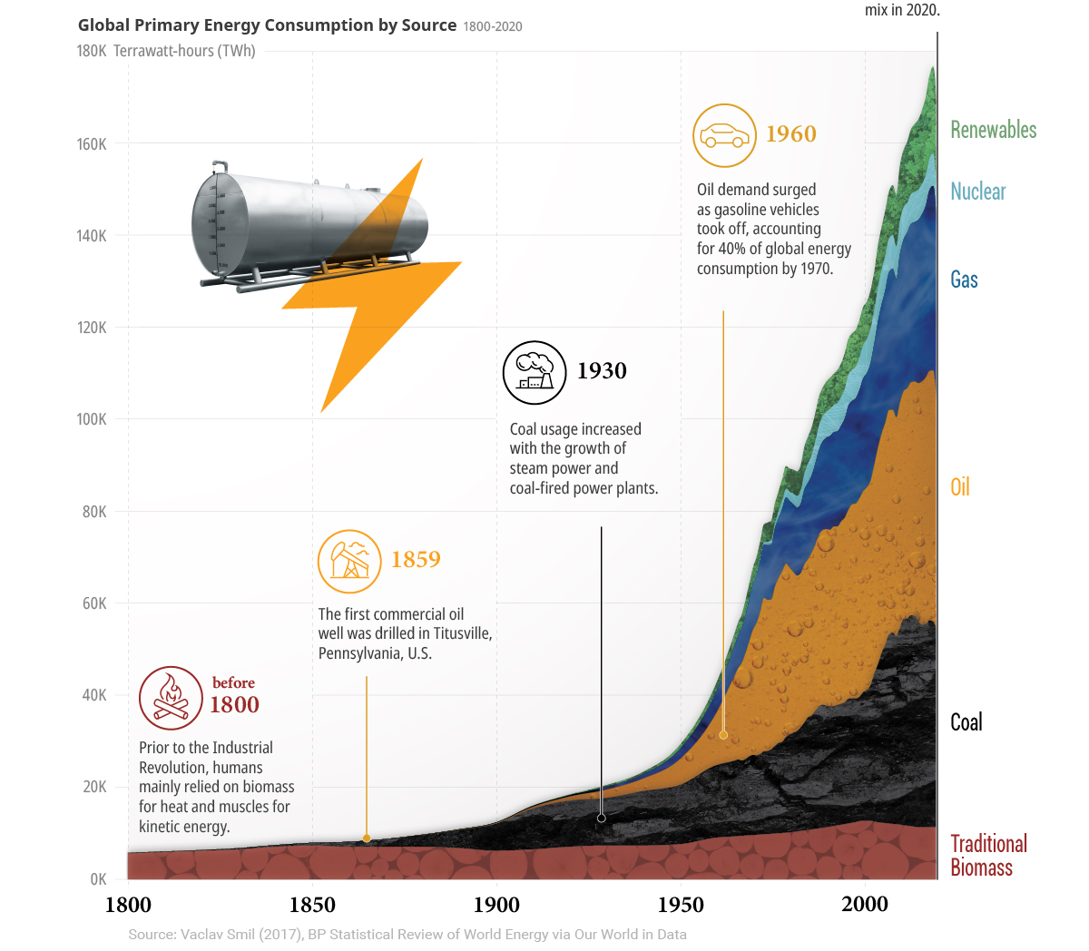
Energy Transition
Fossil fuel accounts for 60 to 80% in 2020

Slide 9
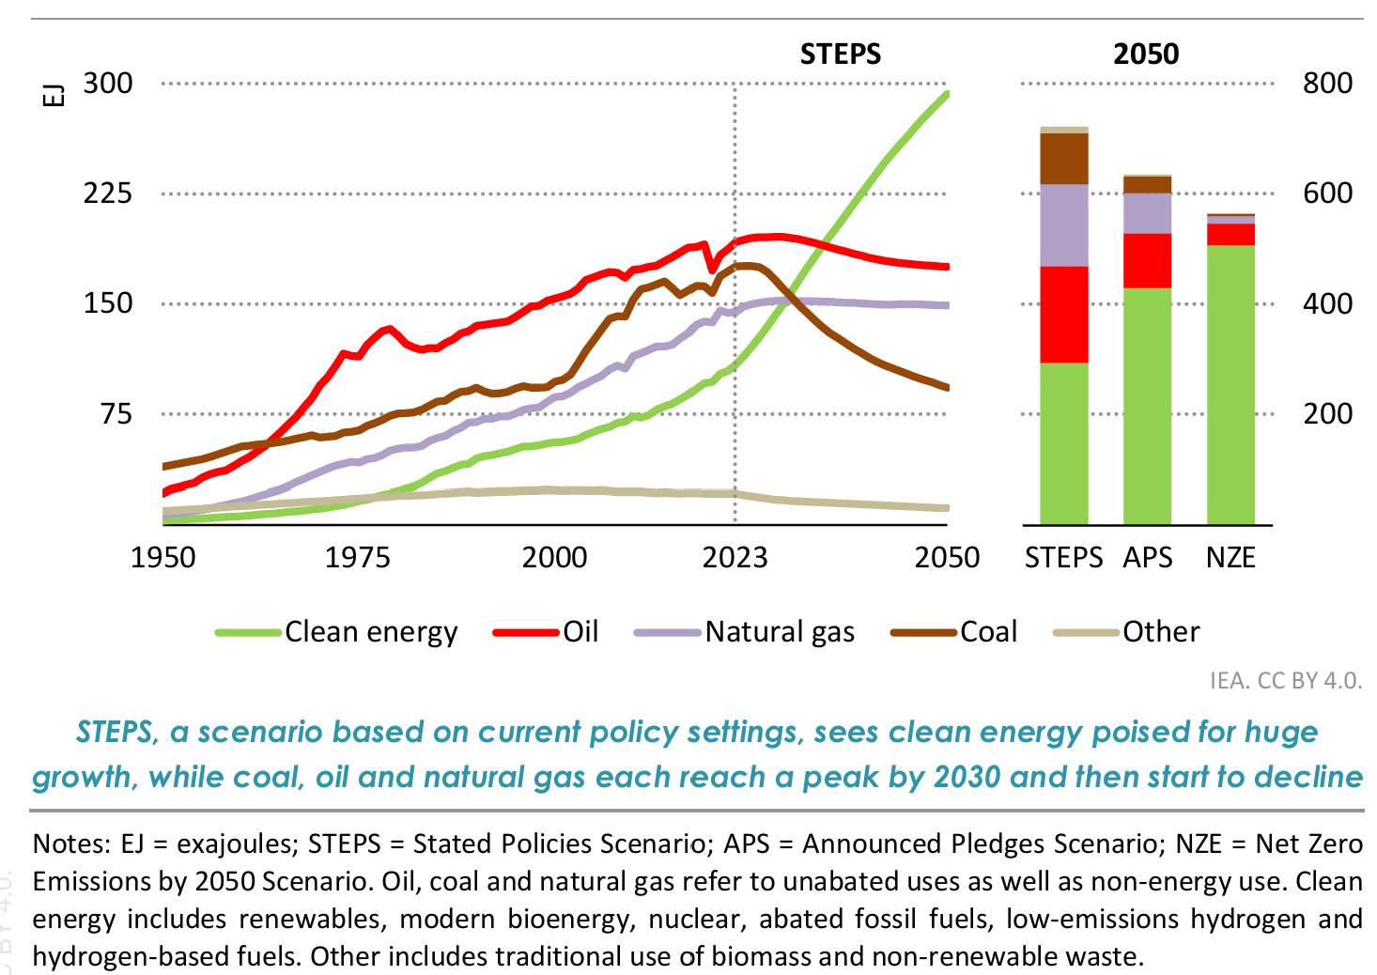
Global Energy Demand and Sources

Slide 10
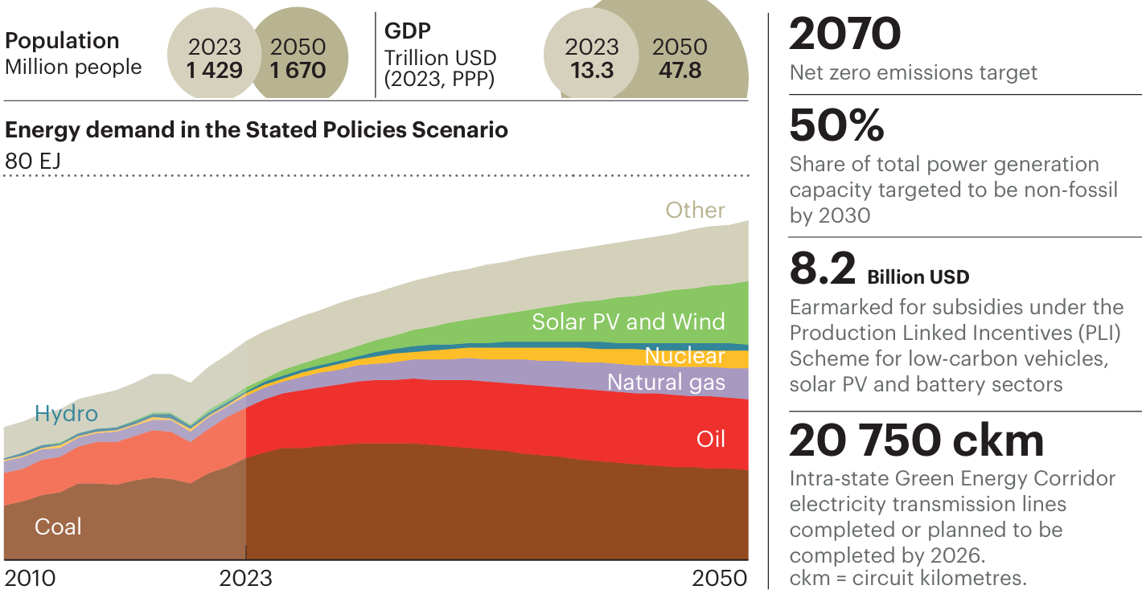
India’s Energy Demand

Slide 11
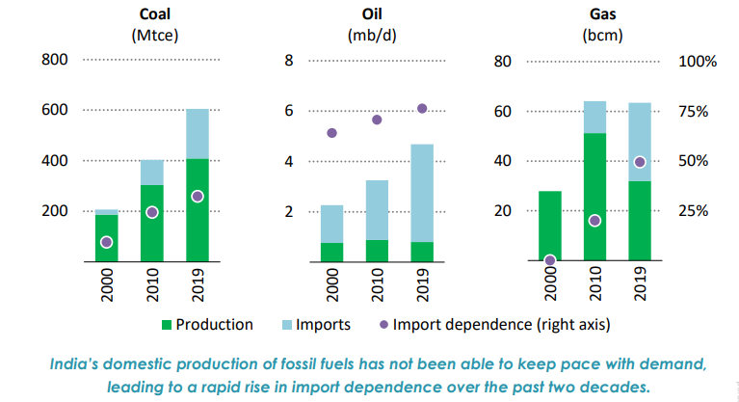
India’s Fuel Scenario

Slide 12
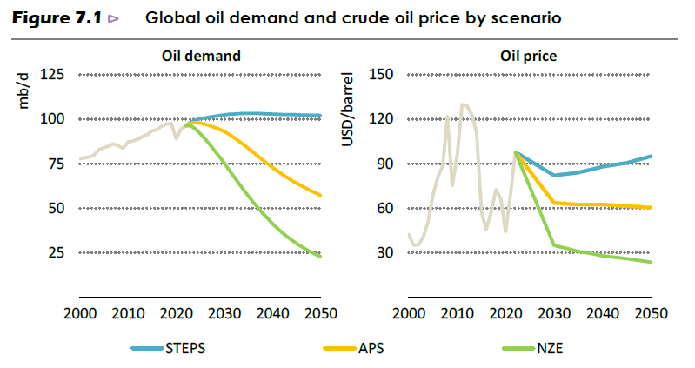
Energy Security
Continuous availability of energy in various forms in sufficient quantity at reasonable prices
Not depend on one fuel as well as country for import

Slide 13
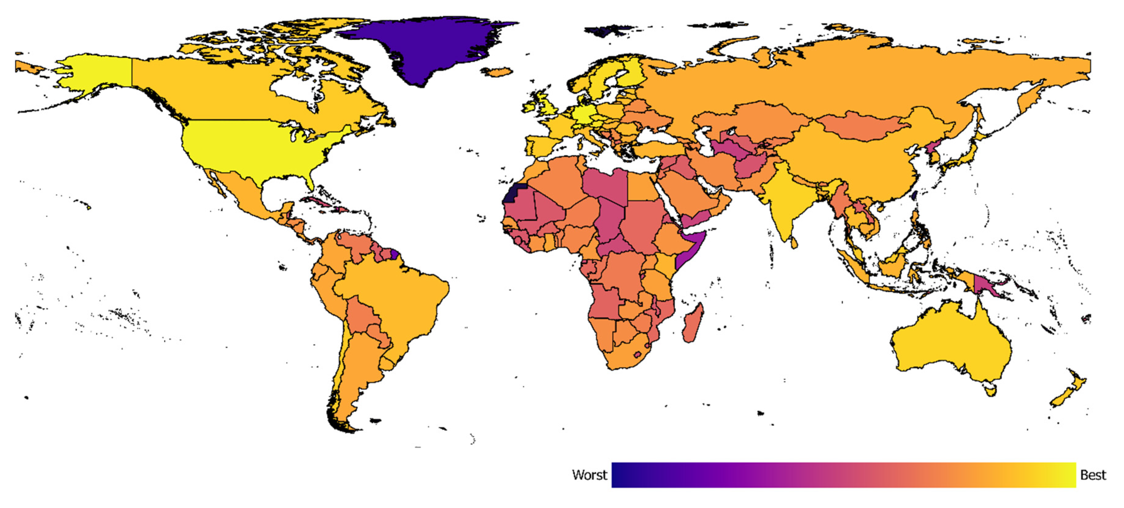
Energy Security

Slide 14
How to improve the energy security
Reducing the energy requirements
Diversifying the energy supply sources
Substituting imported energy resources with domestic alternatives
Expanding energy resources and developing alternative energy resources

Slide 15
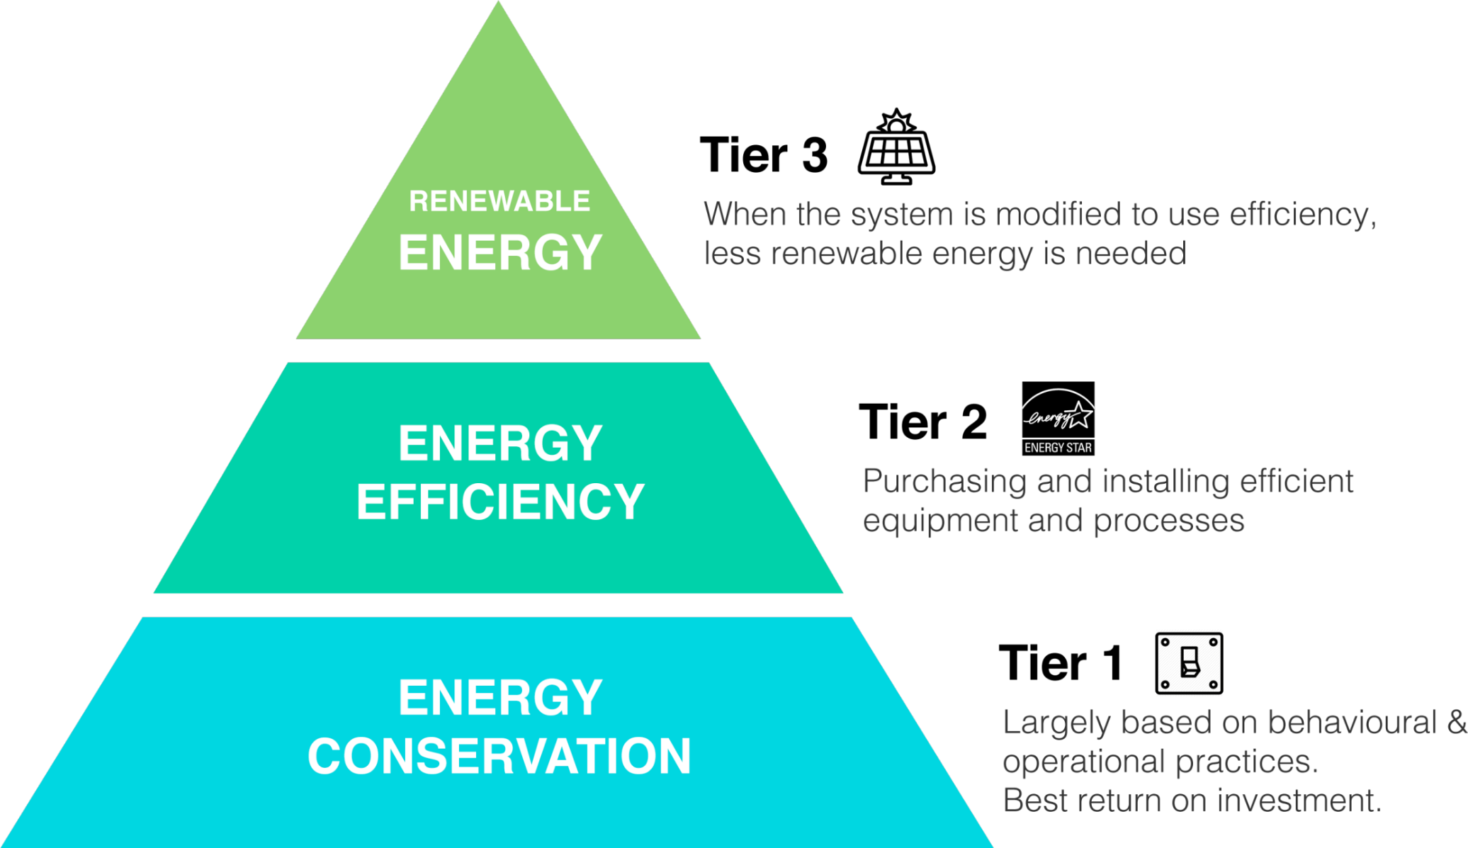
Energy Pyramid

Slide 16
Energy Management
Objective
The judicious and effective use of energy to maximize profits (minimize costs) and enhance competitive positions
Sub-objectives
Improving the energy efficiency and reduce the energy use
Reduce the green house gases and improving air quality
Improving the national energy security index
Reduce the impact of brownouts or interruption in supplies

Slide 17
Why Energy Management
Present consumption pattern predominantly fossil fuel based
Limited fossil reserves
Adverse environmental impacts
Renewables – In general not yet cost-effective
Gestation period for new power plants
Capital cost requirement for new capacity……….

Slide 18
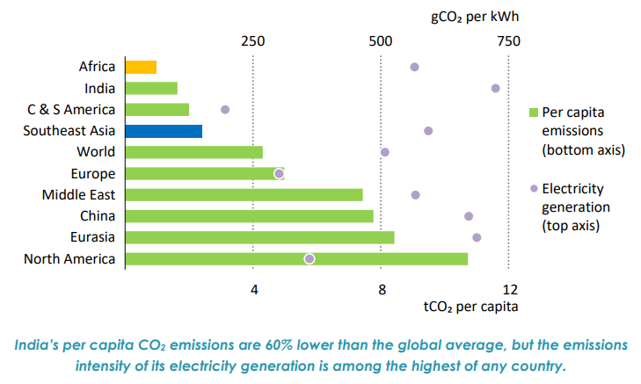
India’s CO₂ Emission

Slide 19
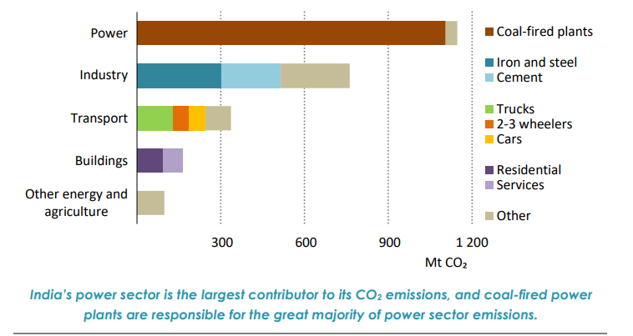
India’s CO₂ Emission

Slide 20
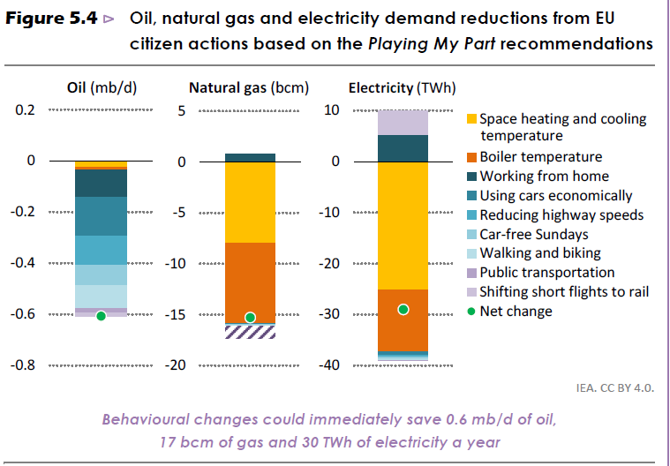
Energy Conservation

Slide 21
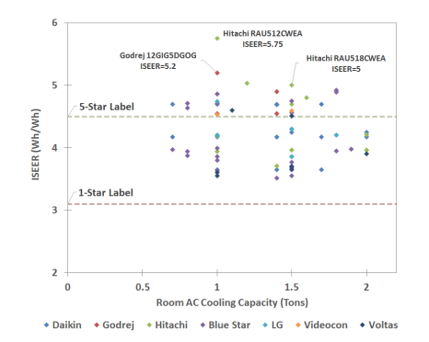
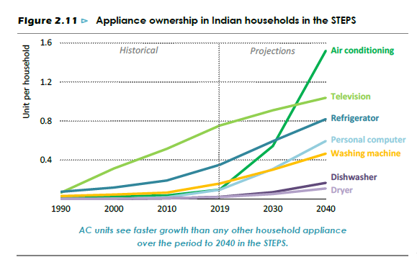
Energy Efficiency - Often considered as an alternative fuel

Slide 22
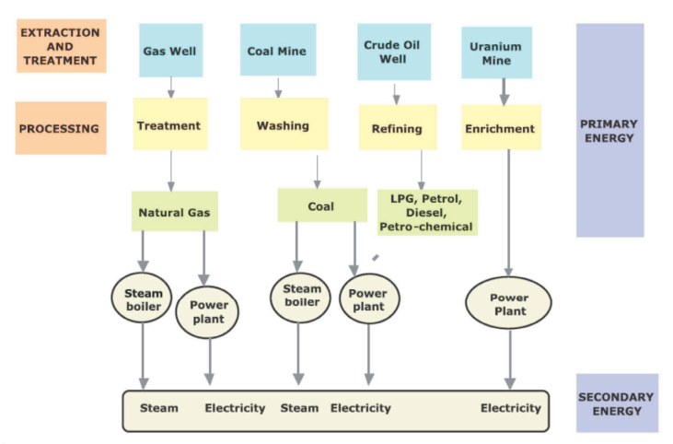
Flow of Energy
Treatment – Sulfur
Washing – Sulfur, Ash and Slag
Refining – Extract different types of oil
Enrichment - Increasing the percentage of Uranium-235

Slide 23
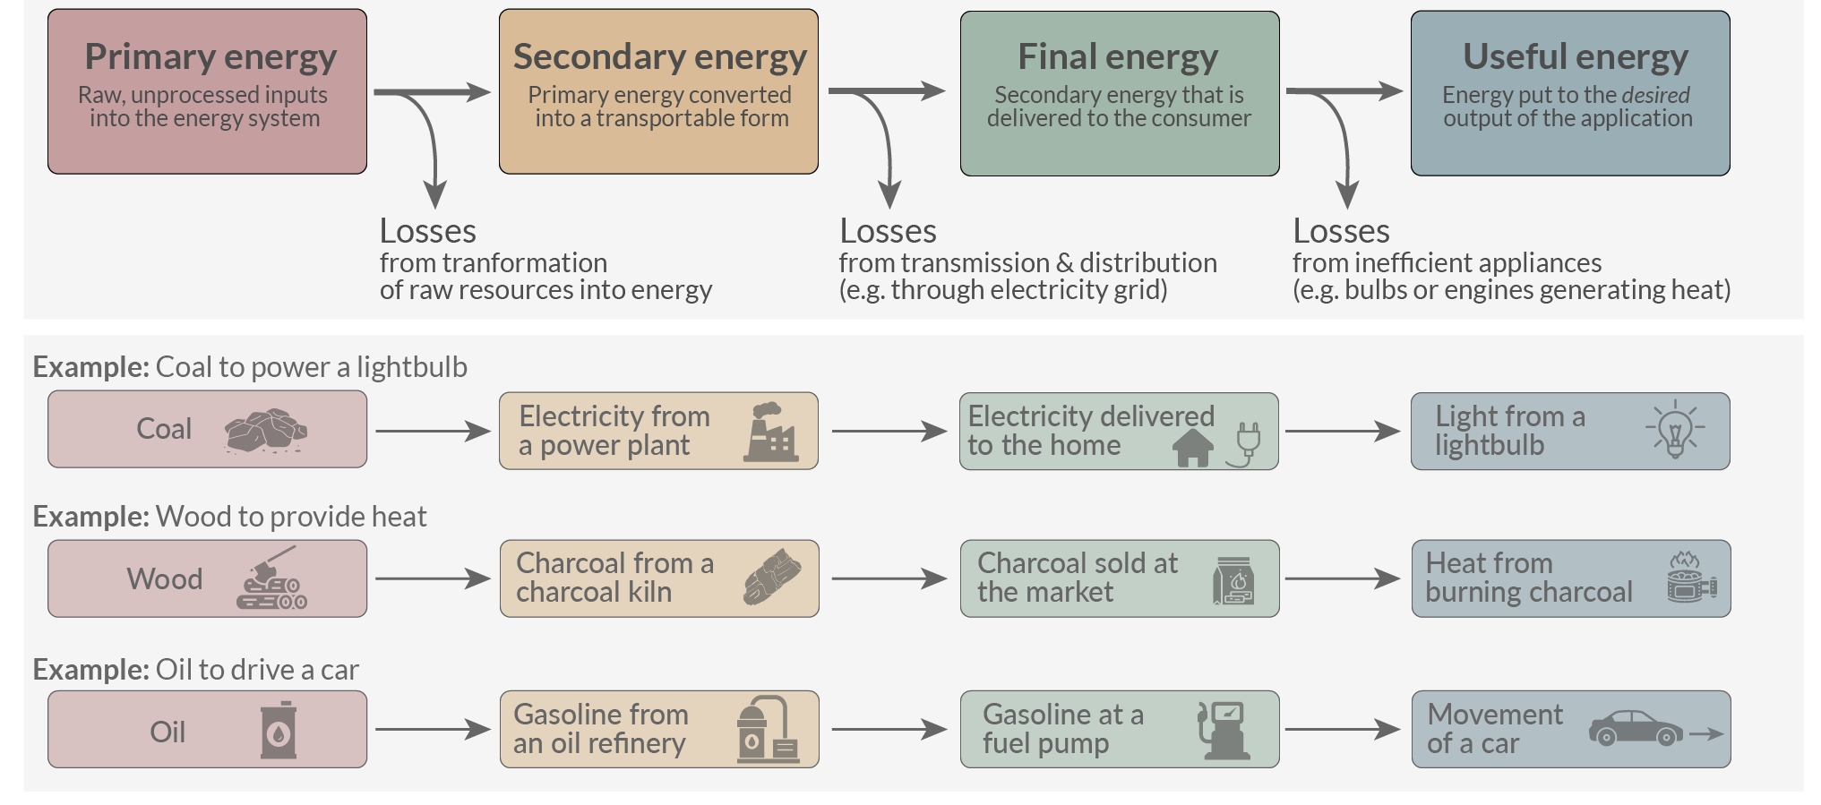
Flow of Energy

Slide 24
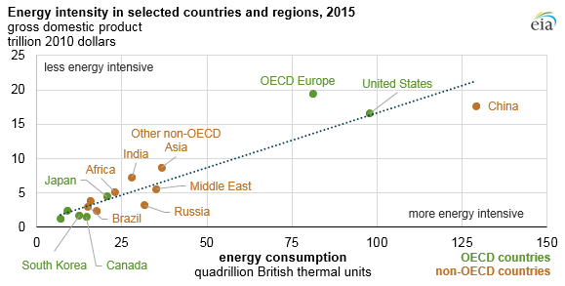
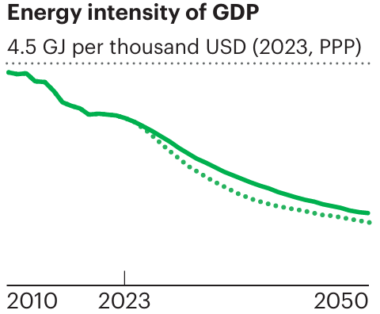
Energy Intensity
Energy intensity is a measure that is often used to assess the energy efficiency of a particular economy
Ratio of energy use to gross domestic product
Low energy intensity is the desired goal
Trying to decouple energy use and economic output to enhance that quality
How will affect our life?

Slide 25
Energy Management and Audit
Continuous improvement of a building Vs timely study
Audit may be considered the first step of this process
Audit – financial connotation – examination with an intent to verify
Energy audit – coined in the 70’s after the oil shocks
A study of a plant or facility to determine how and where energy is used and identify methods for energy savings
The key to a systematic approach for decision-making in the area of energy management
Translation of energy conservation ideas into realities

Slide 26
Remember
Efforts should not be equated with discomfort
Should not interfere with the preliminary function of the organization or facility
Activities that disrupt or impede with the normal functions of the workers and/or processes, , adversely affect productivity constitute false economics
It should be a systematic process to avoid above factors

Slide 27
Recap
Global and Indian energy scenario
Energy security and intensity
Flow of energy
Intro to energy management

Slide 28
References
World Energy Outlook 2024 by International Energy Agency
https://www.eia.gov/todayinenergy/detail.php?id=27032
https://www.mdpi.com/1996-1073/13/10/2502
Energy and Civilization by Waseda University, SILS, Science, Technology and Society (LE202) http://www.f.waseda.jp/sidoli/STS_Intro_06.pdf
BP Energy statistical review of World Energy, 2017
https://www.123rf.com/clipart-vector/energy_conservation_charts.html
https://ourworldindata.org/energy-definitions
Accelerating Improvements in the Energy Efficiency of Room Air Conditioners (RACs) in India: Potential, Cost-Benefit, and Policies (Interim Assessment) Nikit Abhyankar Nihar Shah Won Young Park Amol Phadke
Energy Efficiency: Concepts and Calculations BY Daniel M. Martínez, Ben W. Ebenhack and Travis P. Wagner

